Slide 1
Exception handling
What is Exception & Exception Handling?
An event that disrupts the normal flow of the program. To maintain the normal flow of the application, exception must be handled.
If an exception has occurred, the method creates an Object known as an Exception Object and hands it off to the run-time system(JVM). The exception object contains the name and description of the exception and the current state of the program where the exception has occurred. Creating the Exception Object and handling it in the run-time system is called throwing an Exception

Slide 2
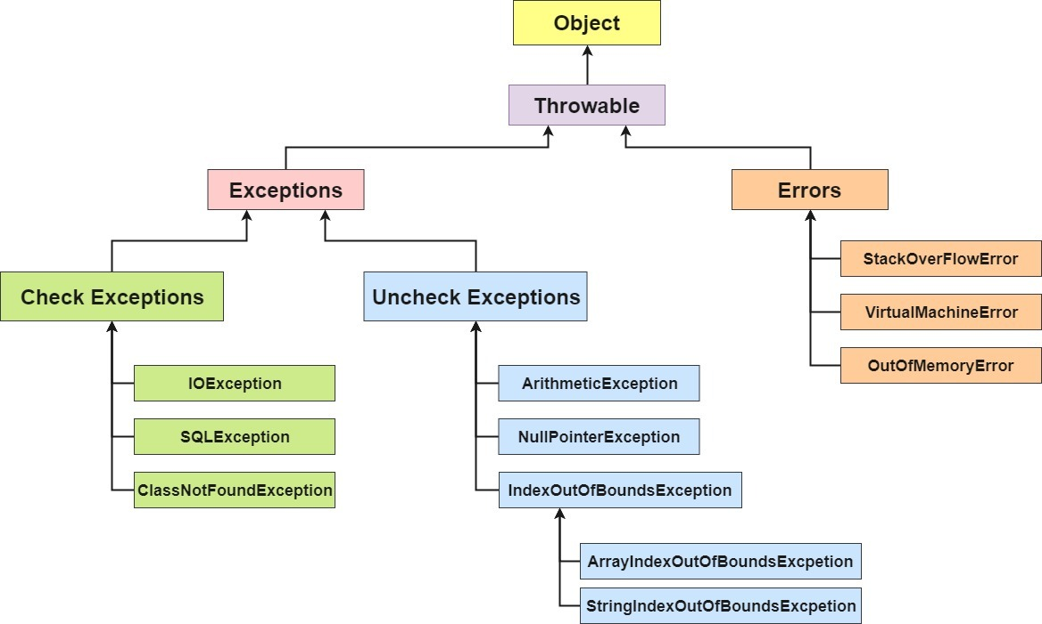
EXCEPTION HIERARCHY

Slide 3
Exception types and Keywords used to handle the exception
Checked Exceptions:
Exceptions that are checked at compile-time by the compiler.
Unchecked Exceptions:
Exceptions occurring at run-time. This will not be checked by the compiler at compile time.
User-Defined Exceptions
The built-in exceptions in Java are not able to describe a certain situation. In such cases, users can also create exceptions, which are called ‘user-defined Exceptions. By using this, User can send appropriote exception/error message.
Java Keywords used in Exception Handling:
try | a block where we should place an exception code
catch | used to handle the exception
finally | used to handle the exception
throws | used to declare exceptions. It specifies that there may occur an exception in the method
throw | used to throw an exception

Slide 4
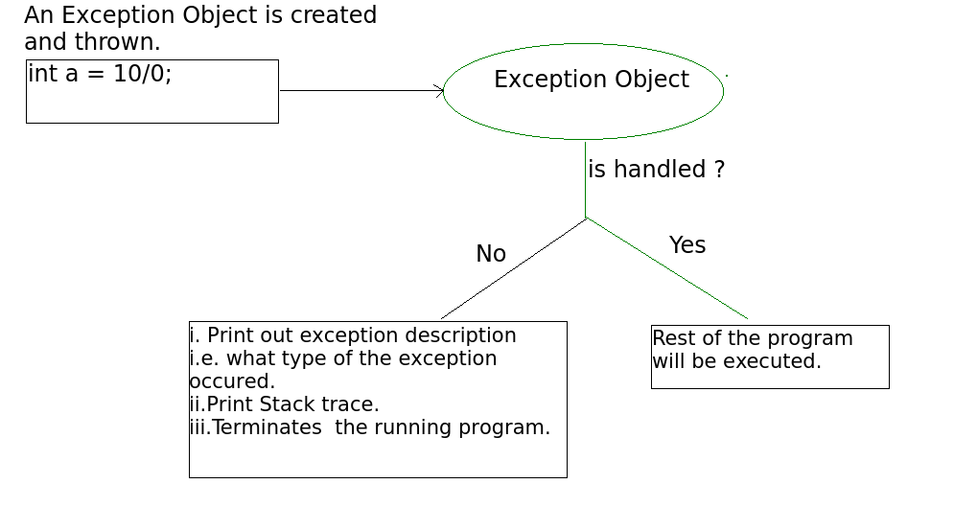
Exception Flow and Methods to print
printStackTrace() – This method prints exception information in the format of Name of the exception: description of the exception, stack trace.
toString() – This method prints exception information in the format of Name of the exception: description of the exception.
Ex: / by zero
getMessage() -This method prints only the description of the exception.
Ex: java.lang.ArithmeticException: / by zero at GFG.main(File.java:10)
Ex: java.lang.ArithmeticException: / by zero
Exception Propagation:
An exception is first thrown from the top of the stack and if it is not caught, it drops down the call stack to the previous method. If not caught there, the exception again drops down to the previous method, and so on until they are caught or until they reach the very bottom of the call stack. This is called exception propagation.

